Slide 1

MEDOPT Web Development+ Data Mining + Machine Learning

Slide 2
Contents
Problem Statement
Proposed System
Scope
Hardware Requirements
Software Requirements
System Design(Flow chart and Design page templates)
System Implementations and Methodologies
Tests & Result
Conclusion

Slide 3

Problem Statement
Due to the variety of possibilities and individual differences in drug responses, customers often struggle to identify alternatives to prescription medications.
Current systems struggle to offer alternatives when first medicines are ineffective or inappropriate and lack individualized recommendations.
Utilizing patient-specific data and cutting-edge algorithms, an advanced medicine alternative recommendation system is required to provide precise and individualized alternative drug options, improve treatment outcomes, and increase patient safety.

Slide 4
Existing System
Websites that provide users with information and recommendations on medical conditions, treatments, and healthcare providers have become incredibly popular.
India's 1mg is an online healthcare portal that offers a variety of services about medications, healthcare items, and diagnostic procedures.

Slide 5
Proposed System
MEDOPT is a website that helps customers find alternative medications, and lists uses, side effects, and chemical formulas.
The proposed Medical Alternative Recommendation System (MEDOPT) aims to solve the issue of providing customized and knowledgeable alternative drug options to patients when the prescription is not appropriate or possible.
System utilizes patient data, medical expertise, and advanced algorithms for personalized medicine recommendations.

Slide 6
Scope
The desire for alternative therapies among patients influences their inclusion in medical practice and prompts healthcare providers to take them into consideration.
The strategy can be used by both common people and healthcare professionals to find alternative pharmaceuticals and their applications and side effects.
In the future, more medications could be added while still finding superior alternatives among the many available drugs.
Limitations:
Lack of medical data may prevent MEDOPT from offering pharmaceutical substitutes.
Collecting data is a challenging task

Slide 7
Hardware Requirements
Server Infrastructure: In order to handle the computational demands of processing large datasets, running complex algorithms, and serving multiple concurrent users, MEDOPT typically requires a robust server infrastructure.
Large datasets must be processed and stored efficiently, so there must be enough memory (RAM). The amount of RAM needed will depend on the size of the dataset, the difficulty of the algorithms, and the number of concurrent users accessing the system.
Storage: The MRS needs enough space to store and manage the patient data, medication database, and other pertinent information.
The hardware configuration should have the necessary security safeguards, like firewalls.

Slide 8
Software Required
Visual Studio Code (VS Code)
VS Code is a powerful code editor with intelligent completion, syntax highlighting, and Git integration.
Jupyter Notebook
Provides an easy-to-use and interactive environment
Figma
Figma is a cloud-based design tool for UI and UX design, enabling simultaneous work among multiple team members on projects.
Django
Django is an open-source Python framework for efficient web application development.

Slide 9
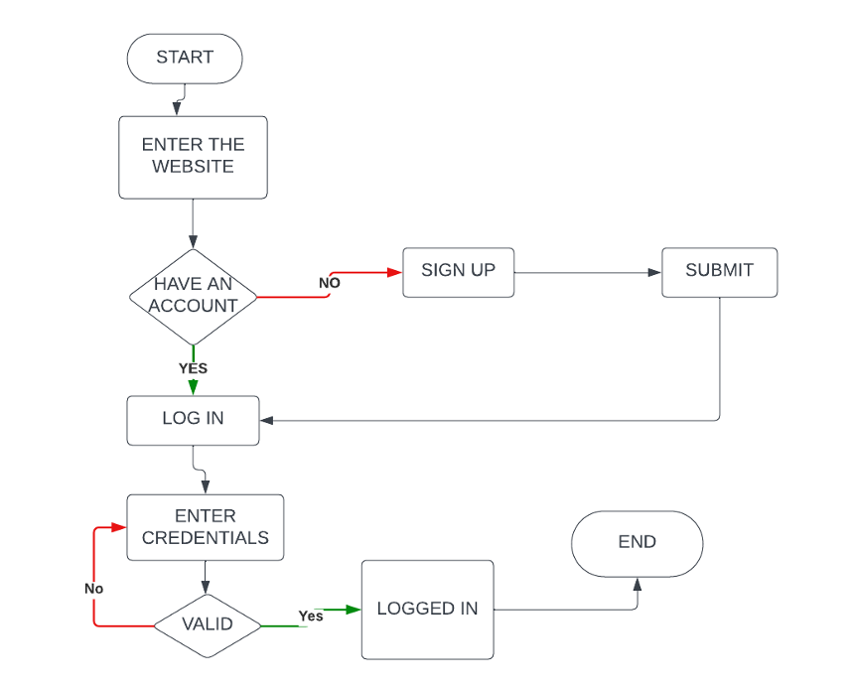
System Design
Login Flow chart

Slide 10
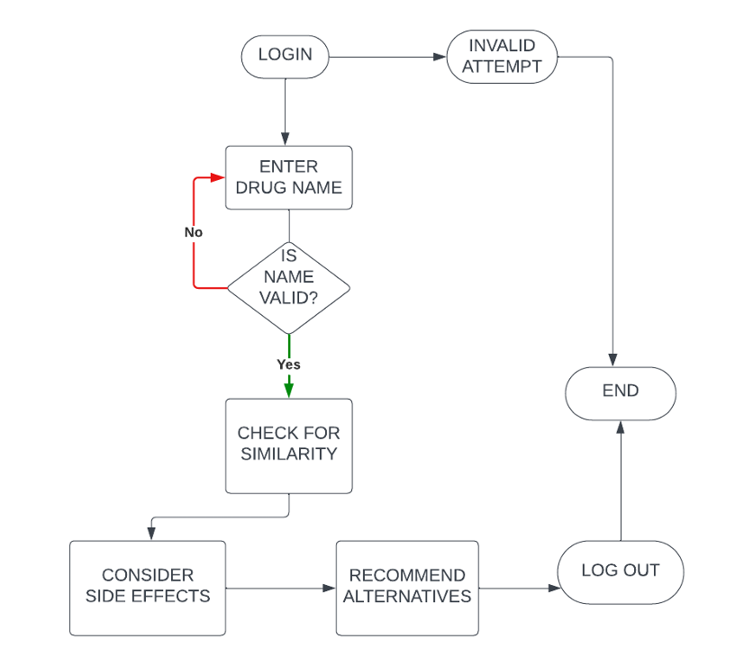
System Design
Functionality Flowchart

Slide 11
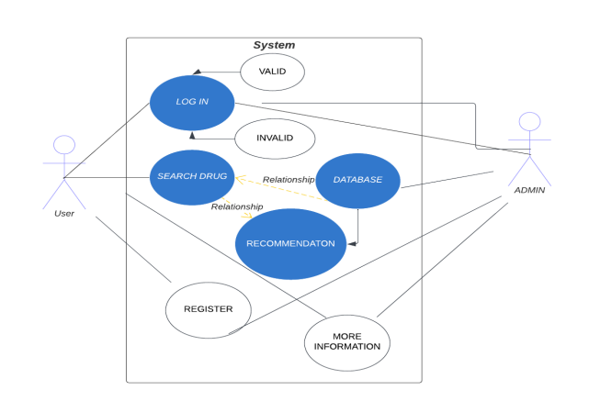
System Design
Use case diagram

Slide 12
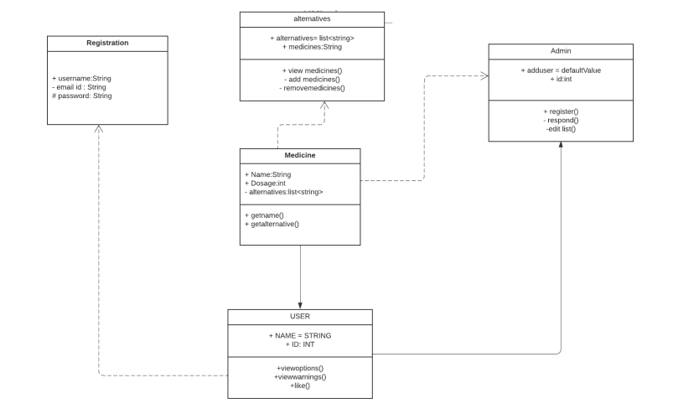
System Design
Class diagram

Slide 13
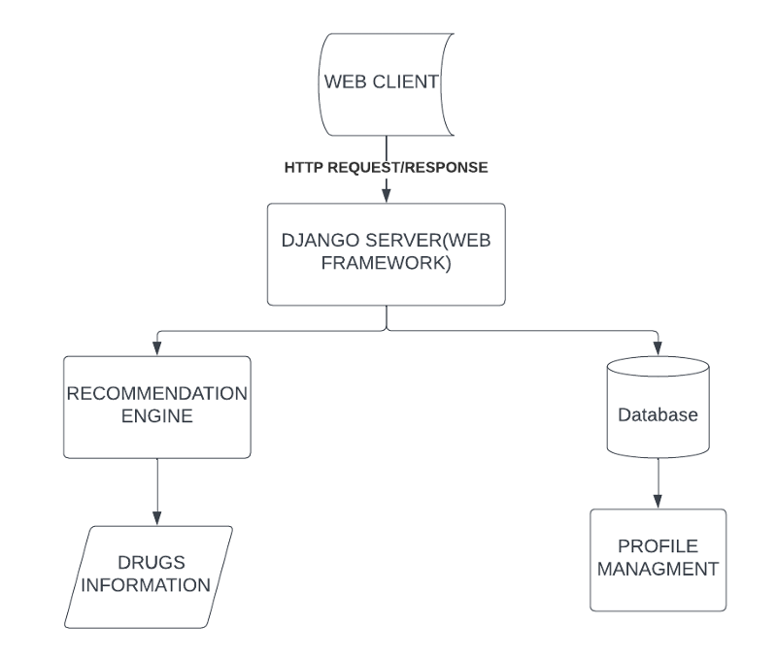
System Design
System Architecture

Slide 14
Implementation
The implementation includes various steps
Data Collection and Storage
Gather relevant data
Create a database
Recommendation Engine
Data preprocessing
Recommendation algorithms
User interface
Recommendation generation: Implement the logic in the application layer that interacts with the recommendation engine to generate alternative medicine recommendations based on user inputs and preferences.

Slide 15
Implementation
Algorithm
Data Representation
Text Vectorization
Cosine Similarity

Slide 16
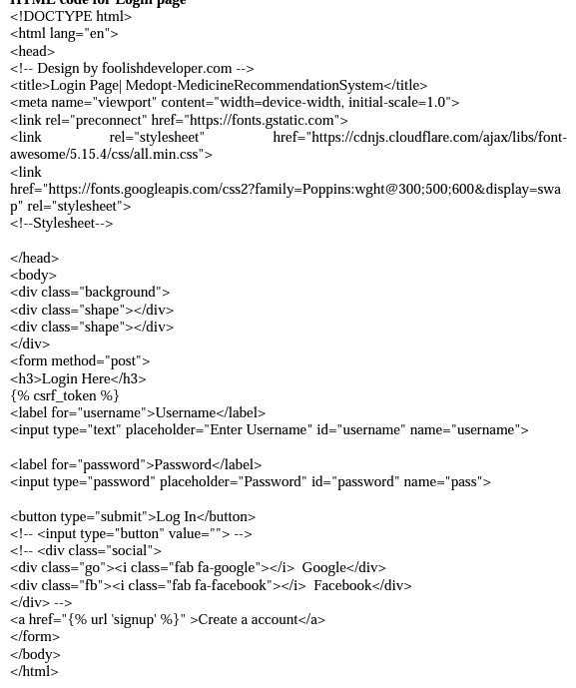
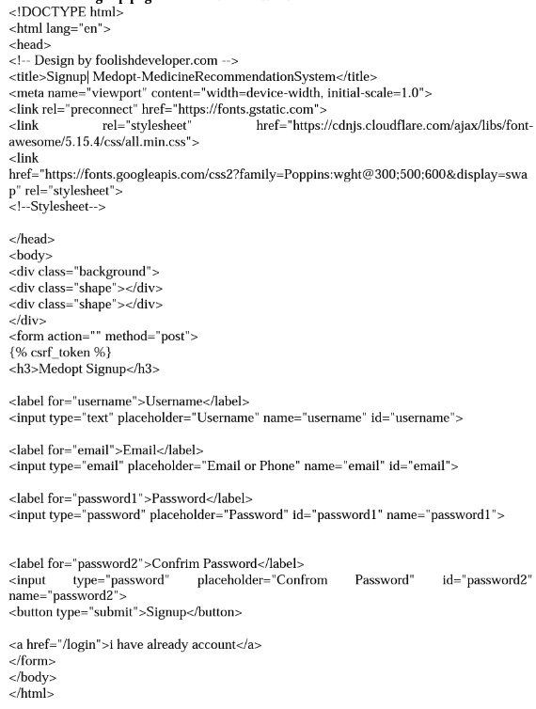
Sample Code
Login page
Signup page

Slide 17
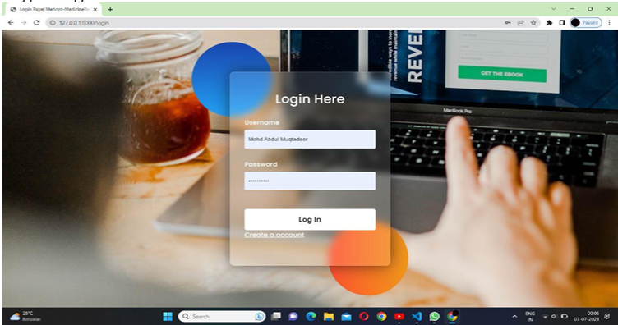
Login page

Slide 18
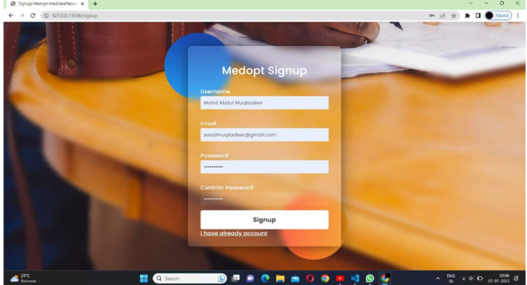
Signup page

Slide 19
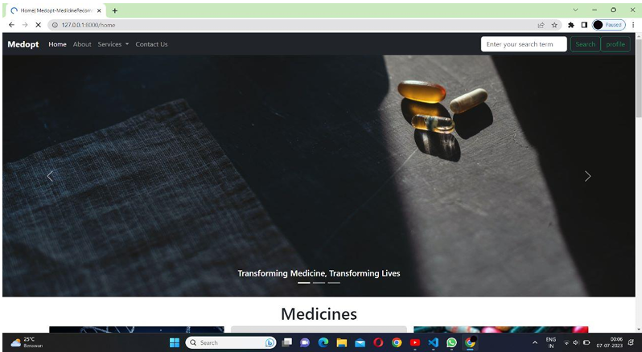
Home Page

Slide 20
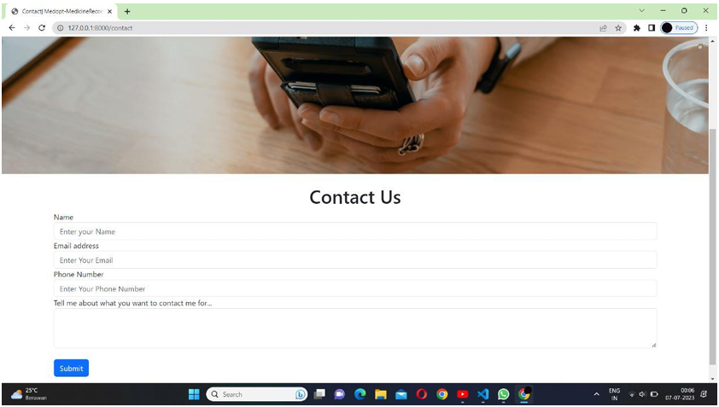
Contact us page

Slide 21
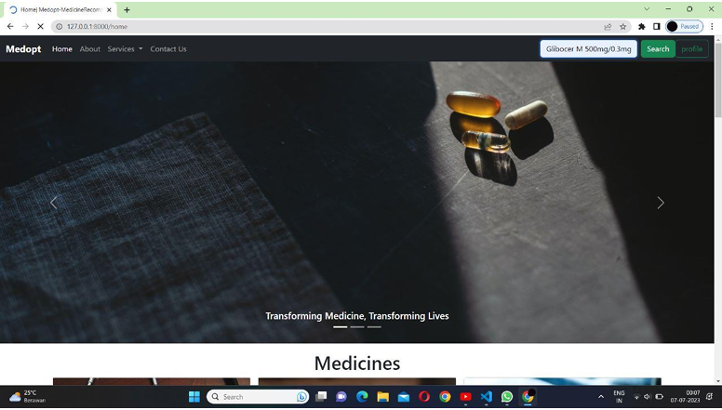
Test Case 1
Input : Gibocer M 500mg/0.3 mg tablet

Slide 22
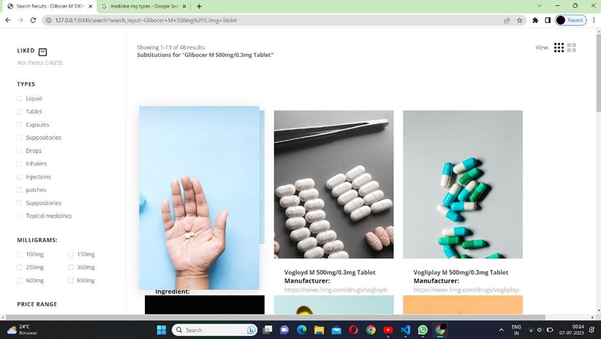
Output

Slide 23
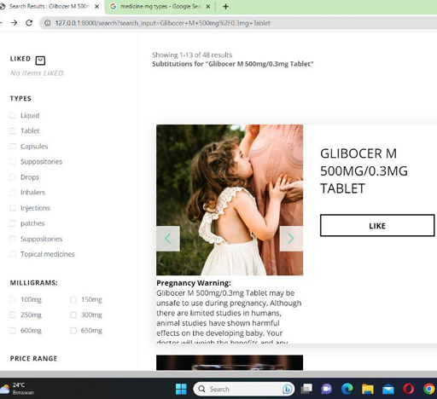
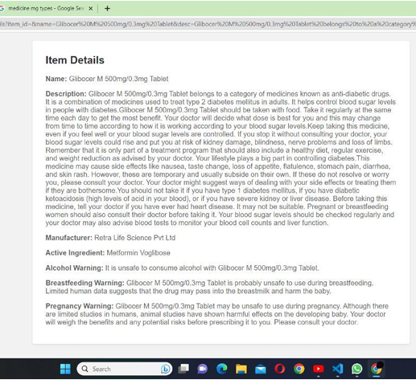
Upon hovering
Upon clicking
Output

Slide 24
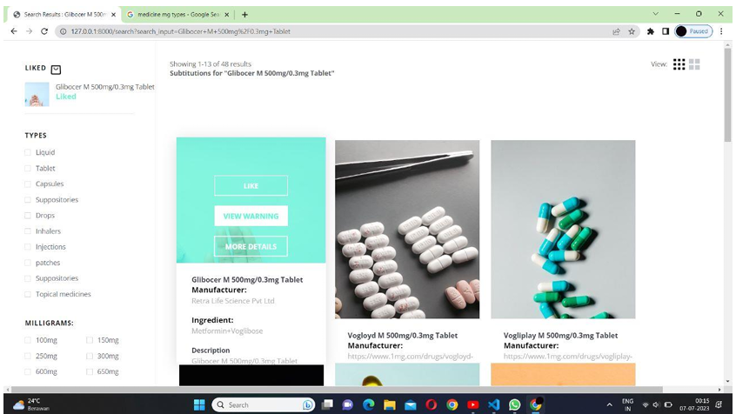
Output

Slide 25
Conclusion
A system for alternative medicine can provide users with helpful suggestions so they can research different types of treatments and choose wisely when it comes to their health

